Slide 1
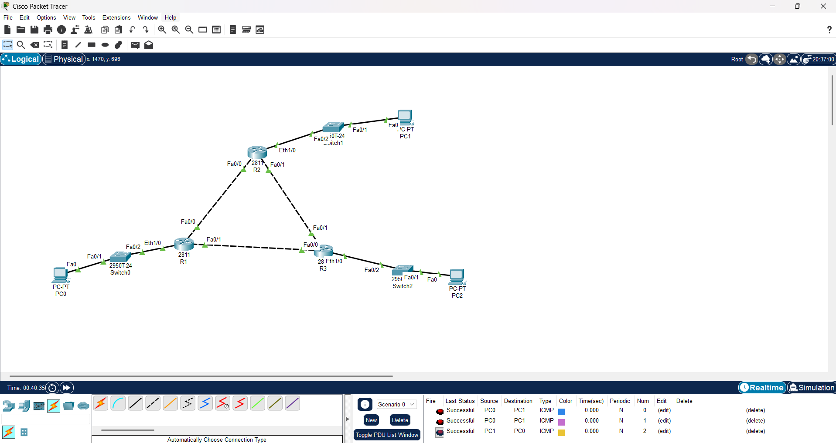
PH1- CISCO PACKET TRACKER: SUCCESSFUL TFC FLOW

Slide 2
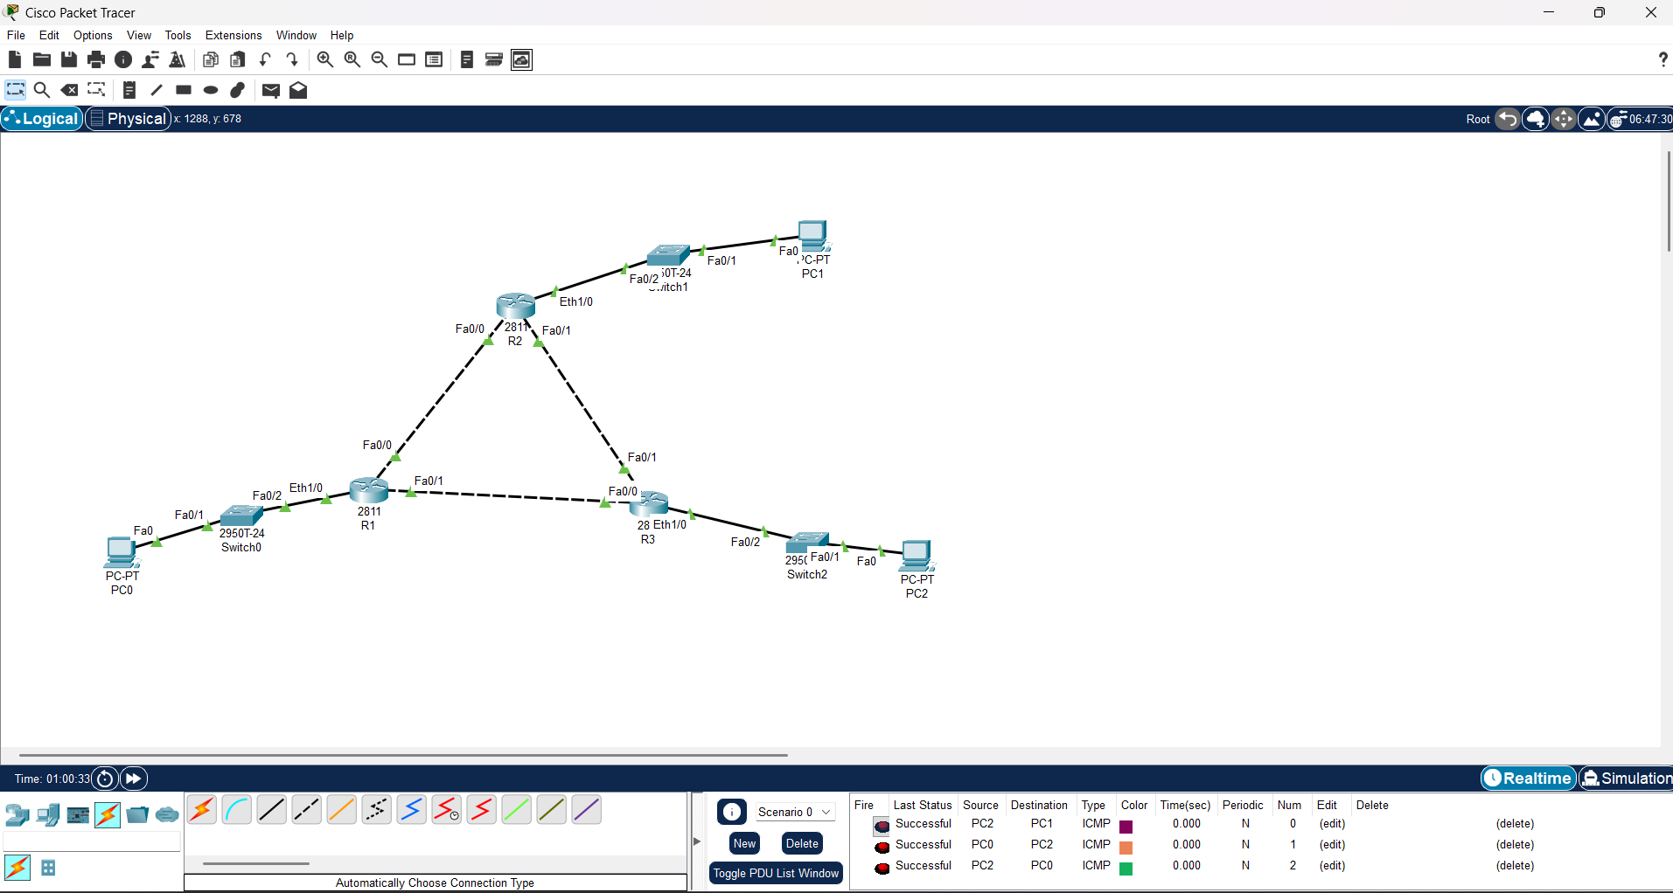
PH1- CISCO PACKET TRACKER: SUCCESSFUL TFC FLOW (ALL PCs)

